Slide 1
Relational Databases and SQL
June 8, 2016
Chris Schmitz and Bryan Jones

Slide 2
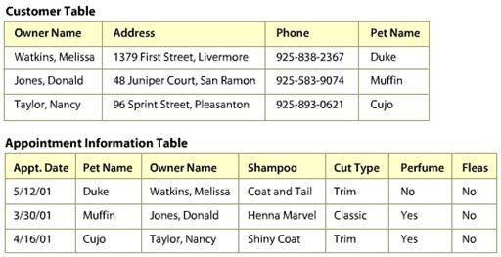
What is a Relational Database ?
Collection of data in physical files on a computer
Data is stored in TABLES (e.g. Books, Users, Bars)
Each table contains ROWS (an specific instance)
Each row contains COLUMNS
Each column represents a single item of data
Relational Algebra and Set Theory
E.F. Codd (1970’s)
Access data in different ways w/o restructuring the data
Data is Very Structured!

Slide 3
What is a Relational Database ?
Data (actual data stored)
Column value of “Watkins, Melissa”
Metadata (data about the data)
Column name is “Owner Name” w/ a “VARCHAR” data type
Various Data Types (VARCHAR, NUMERIC, DATE)
Indexes … Constraints … Users … Groups
Why RDBMS?
Data Integrity … Low Storage Costs… ACID… Solid thinking about your Business

Slide 4

Data Types
Numbers
Characters (VARCHAR vs. CHAR)
Dates and Times
Auto increment
Enums
Binary Large Objects (BLOBs)
JSON …. XML … Key Value Pairs
Spatial (e.g. longitudes and latitudes)
NULL
“Unknown state of a value”
Bad because :
- Unexpected query results
- Incomplete thinking about your business
- Use ISNULL syntax to find NULLs

Slide 5
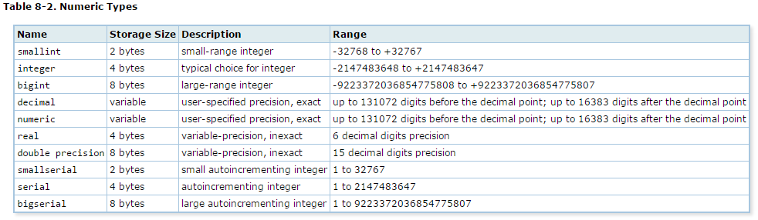

Data Types – Numbers
Smaller is better!
Tinyint – 1 Byte …. Mediumint – 3 bytes
Unsigned – 0 to MAX

Slide 6
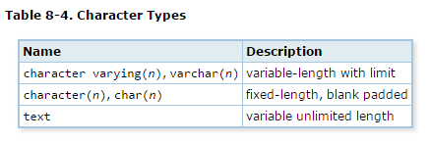
Data Types – Characters
Use CHAR(n) when :
The values are short - OR -
You know the length in advance
CHAR(2) ‘MO’ = 2 bytes … ‘M’ = 2 bytes … ‘MOLE4’ = n.a.
CHAR(5) ‘MO’ = 5 bytes … ‘M’ = 5 bytes … ‘MOLE4’ = 5 bytes
VARCHAR(100) ‘MO’ = 3 bytes ... ‘M’ = 2 bytes … ‘MOLE4’ = 6 bytes

Slide 7
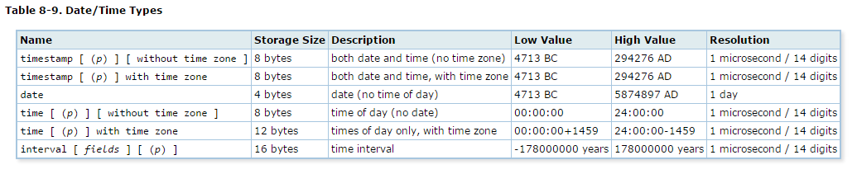
Data Types – Dates and Times
Boo yah!!!

Slide 8




What is a RDBMS ?
Relational Database Management System
Software to Update and Query the Database
Questions and Commands can be posed to the Database
SQL
“Which bars are in St. Louis?”
“Which bars have a rating of 4 or higher?”
“Insert a new bar record in the Bar table… NOW!”

Slide 9
Talking To Our Database…
SQL – Structured Query Language
Communicate Directly w/ Our Database
SQL is Declarative (“What”) … NOT Imperative (“How”)
Results are Returned in a Virtual Table
4 Ways to Interact w/ Our Database :
1. Data Control … 2. Data Definition … 3. Data Manipulation … 4. Data Query

Slide 10
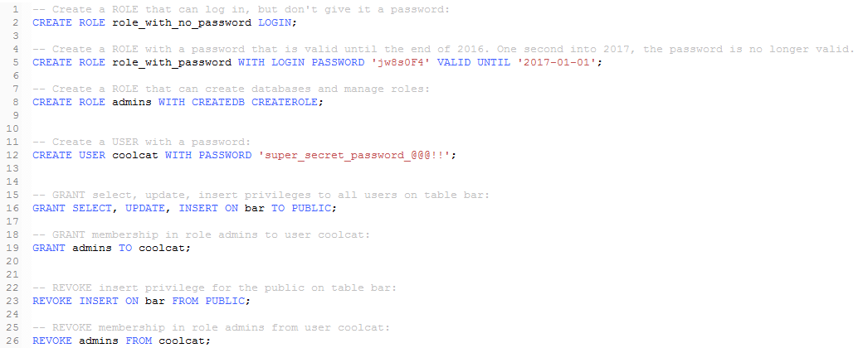
Data Control Language (DCL)

Slide 11
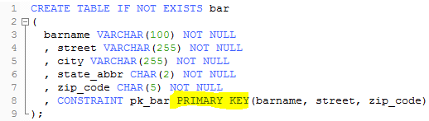
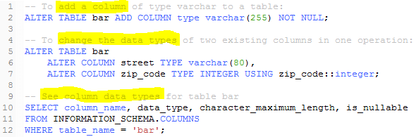
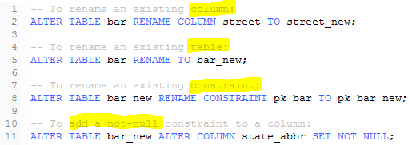
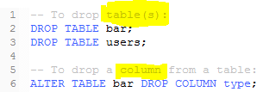
Data Definition Language (DDL)
1. CREATE → Table … Primary Key … Foreign Key … Indexes
3. ALTER → Column
2. RENAME → Table … Column
4. DROP → Table … Column

Slide 12
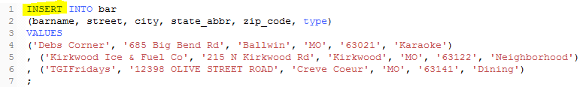
Data Manipulation Language (DML)
“CRUD” Statements (Create … Read … Update … Delete)
“C” : INSERT → Record
“R” : SELECT → Record
“U” : UPDATE → Record
“D” : DELETE → Record
INSERT
UPDATE
DELETE
… vs. TRUNCATE

Slide 13
Data Query Language (DQL)
“CRUD” Statements (Create … Read … Update … Delete)
“C” : INSERT → Record
“R” : SELECT → Record
“U” : UPDATE → Record
“D” : DELETE → Record
SELECT << field names >>
WHERE
Operators (IN, LIKE, Equals, BETWEEN)
GROUP BY .... Aggregates (e.g. SUM, MIN, MAX, AVG)
HAVING
ORDER BY
LIMIT
…. also, DISTINCT (e.g. SELECT DISTINCT city FROM bar;)

Slide 14
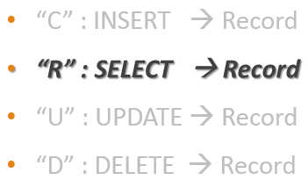
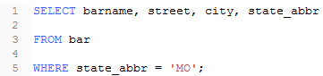
DQL - SELECT Statement
1
Fields to Retrieve
3
Table to Access
5
Filter Criteria for Table

Slide 15
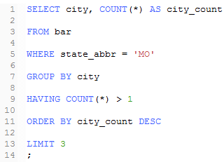
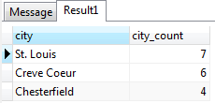
DQL - SELECT Statement
Function
Alias
7
Grouping Condition
9
Filter Criteria for Grouped Condition
11
Order Condition for the Result Set
13
Limit Criteria for Returned Result Set

Slide 16
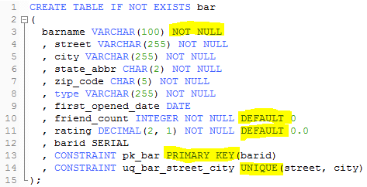
Table Design
Should represent one “thing” of interest to the business (e.g. Bar, Event, Users)
Relevant columns (e.g. attributes) … and no missing columns
Sensible data types for columns
Use a Primary Key constraint (usually)
Use other constraints (Unique, Foreign Keys)
Use Indexes where needed
Should be in Third Normal Form (“3NF”)
Conceptual …. Logical … Physical

Slide 17
Primary Keys, Constraints, and Indexes
Primary Keys (PK’s)
PK’s guarantee each row is unique
Must be unique … NOT NULL … Immutable
PK’s define the Foreign Keys in dependent tables
Start with “natural” PK’s (barname, street, zip) …. Use a Surrogate PK if needed (barid)
Constraints (Unique, Not Null, Foreign Key)
Enforce integrity of your data (e.g. “No dupe emails in Users table” … “We must have a zip code”)
Foreign Keys establish relationships b/w tables
.
Indexes (Covered Index, Hash Index, Filtered Index)
Improve Read (“SELECT”) performance … but Writes take longer
Data is duplicated on different files (and ordered) … points back to original data
Like a book index!

Slide 18
Normalization & Third Normal Form (3NF)
Normalization
Identifying the one best place where each fact belongs
Minimizes redundant or unnecessary data elements
Ensures each entity is well-formed
E.F. Codd (again…)
First Normal (1NF)
Eliminate repeating groups and non-atomic data
Each column contains a single, discrete fact (ATOMIC!)
Second Normal (2NF)
ALL columns of each row are dependent on the entire Primary Key
Third Normal (3NF)
EACH column should only depend on the PK (… does the “city” column in our Bar table follow this rule?)

Slide 19
Normalization & Third Normal Form (3NF)
Not Relational
StudentID (PK) | Name | MajorID | StudentMajor | CourseNum | CourseName | CompDate
0001 | Jones, Bryan | HIST | History | HIST101 HIST201 | Intro to History U.S. History | 2012-12-17 2013-05-31
1NF
and 2NF ?
StudentID (PK) | LastName | FirstName | MajorID | StudentMajor
0001 | Jones | Bryan | HIST | History
3NF
StudentID (PK) | LastName | FirstName | MajorID << FK >>
0001 | Jones | Bryan | HIST
MajorID (PK) | Major
HIST | History
CourseNum (PK) | CourseName | MajorID << FK >>
HIST101 | Intro to History | HIST
HIST201 | U.S. History | HIST

Slide 20
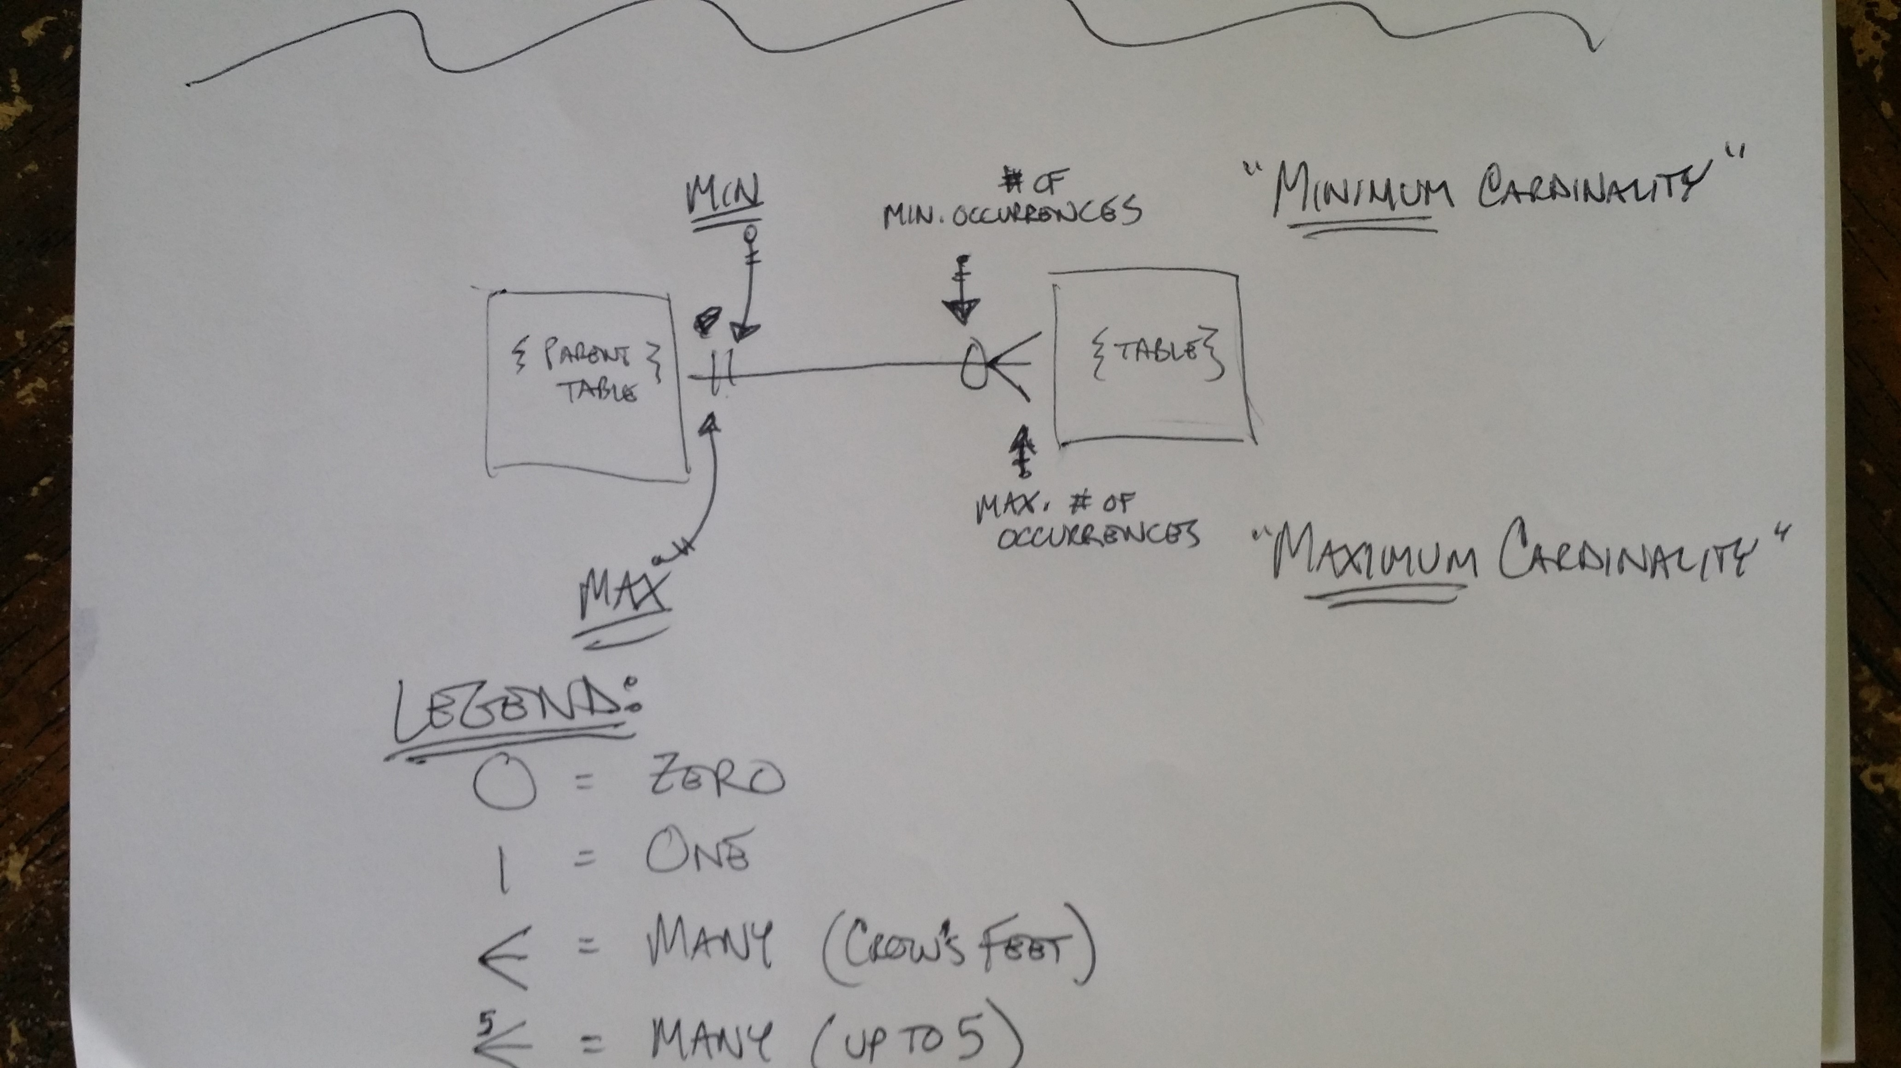
Multiple Tables Basics

Slide 21
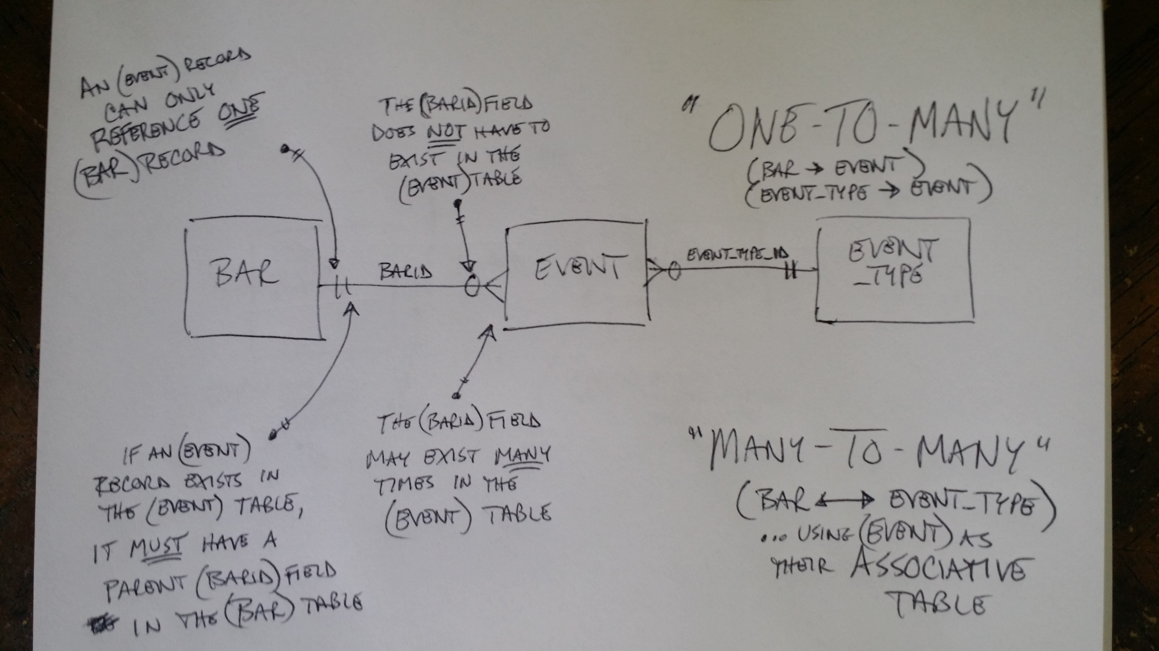
Multiple Tables Basics

Slide 22
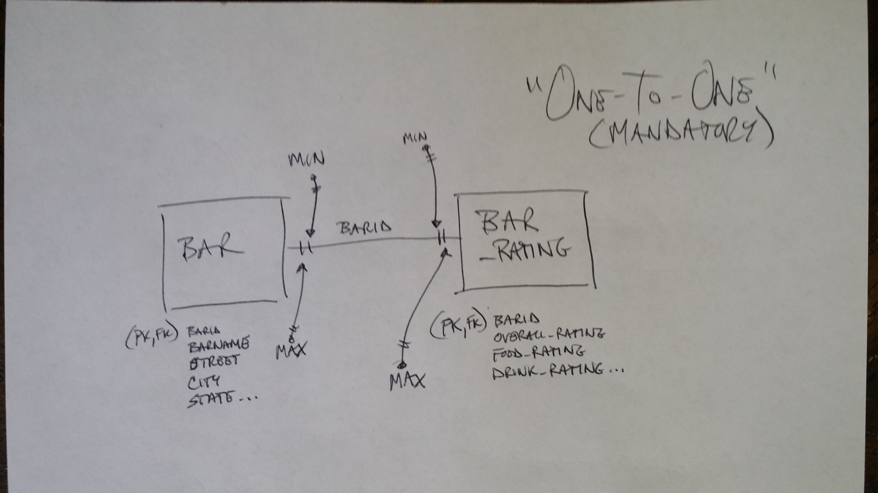
Multiple Tables Basics

Slide 23




NoSQL…
RDBMS not great for everything (esp. Unstructured Data)
Key Value …. Documents …. Columns …. Graphs
Schema vs. Schema-less
ACID vs. BASE
However, NoSQL and RDBMS are converging (Mongo Row Locks …. PostgreSQL JSONB, etc.)

Slide 24
SQL Tips
Small Data Types
Smart Indexing
Minimize Variable Length Data Types
3NF
Reduce amount of data retrieved (WHERE and HAVING)
Minimize Cursors and Row-by-Row Operations (allow Sets to be Sets!)
Be Paranoid! Verify ALL User Input!!

Slide 25
Possible Future Topics
Security : Verifying User Input … SQL Injection … Prepared Statements
Advanced Objects : Triggers … Functions … Procedures … Views … Transactions … CTE’s
Performance : Indexing … Caching … Optimizer … Statistics … Query Plan … RAID
Architecture : Replication… Partitioning … Sharding
Design : Conceptual … Logical … Physical … Requirements Gathering
Administration : Users … Groups … Permissions … Backups and Restores (Cloud?)
Syntax : Vendor Differences … ANSI and ISO Standards
……. and NoSQL !!!

Slide 26

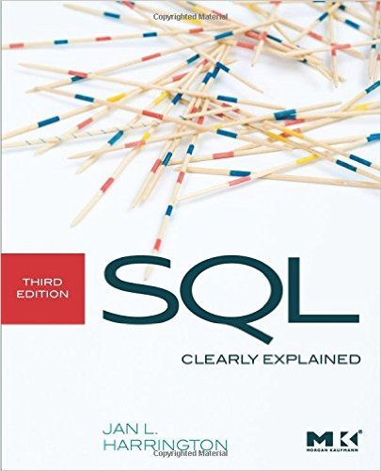
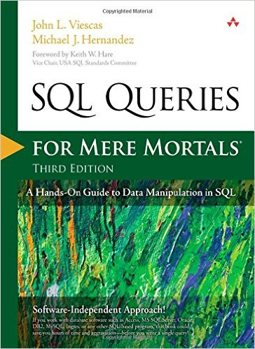
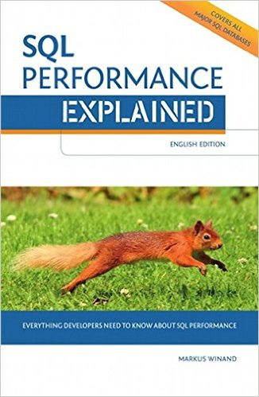
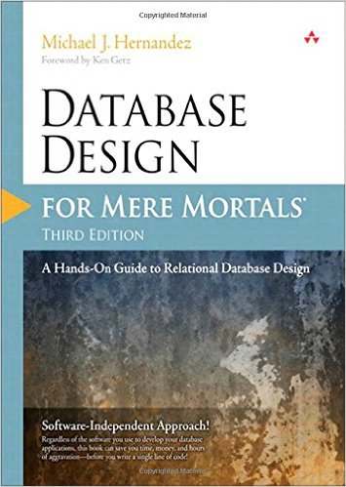
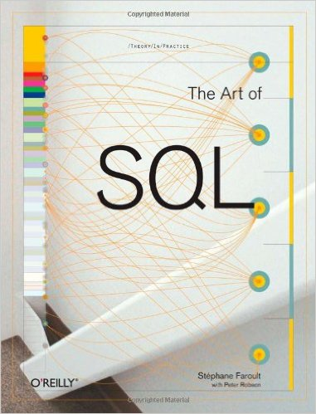
Resources
“Head First SQL”
“SQL Queries For Mere Mortals” (3rd)
“Database Design For Mere Mortals” (3rd)
“SQL Clearly Explained” (3rd)
“SQL Performance Explained”
“The Art of SQL”

Slide 27
DQL - SELECT Statement - Examples
No table – SELECT date();
One table – SELECT * FROM bar;
Filtering – SELECT * FROM bar WHERE state = ‘MO’ ORDER BY joindate DESC;
Filtering – SELECT * FROM bar WHERE type LIKE ‘%Hole%’ ORDER BY joindate DESC;
Filtering – SELECT * FROM bar WHERE type IN (‘Pool’, ‘Hole in the Wall’) ORDER BY joindate DESC;
Filtering – SELECT * FROM bar WHERE joindate BETWEEN ‘2015-01-01’ AND ‘2015-12-31’ ORDER BY joindate ASC;
Filtering – SELECT * FROM bar WHERE city = ‘Creve Coeur’ AND type LIKE ‘%Hole%’;
Filtering – SELECT * FROM bar WHERE city = ‘Creve Coeur’ OR (type LIKE ‘%Hole%’ AND rating >= 4.5);
Filtering – SELECT DISTINCT(joindate) FROM bar WHERE city = ‘Creve Coeur’ ;
Grouping – SELECT type, COUNT(*) AS [count] FROM bar GROUP BY type;
G/F – SELECT type, COUNT(*) AS [count] FROM bar GROUP BY type HAVING COUNT(*) > 1;
G/F – SELECT type, COUNT(*) AS [count], MAX(joindate) FROM bar GROUP BY type HAVING COUNT(*) > 1 ORDER BY [count] DESC;
G/F – SELECT type, COUNT(*) AS [count], MAX(joindate) FROM bar WHERE joindate >= ‘2016-01-01’ GROUP BY type HAVING COUNT(*) > 1;

Slide 28
Multiple Tables Basics
FKs
JOIN(s) .. INNER vs. OUTER vs. RIGHT vs. LEFT vs. CROSS
Cardinality ( 1 to 1 ... 1 to Many ... Many to Many )
Optionality
Sub Queries
UNION vs. UNION ALL

Slide 29
Chris
The types of relationships
How you'd relate tables
Break tables out and create relationships between them
How and why you'd structure supporting tables
How you should pick your fields and why
Leveraging join tables

Slide 30
Items RDBMS … Ignore
Why RDBMs? ...Update! Storage! ACID!
Memory vs. Disk
3NF
Cardinality ( 1 to 1 ... 1 to Many ... Many to Many )
SELECT
WHERE
Operators (IN, LIKE, etc.)
JOIN(s)
Aliases Fields and Tables
GROUP BY .... SUM, MIN, MAX, AVG
HAVING
ORDER BY
Order of Ops Aliases in ORDER BY
PKs ... Reiterate 3NF
FKs
Indexing
Data Types
NULL ... ISNULL()
The Game = Reduce load

Slide 31
Items Other … Ignore
Triggers, Functions, Procedures
Caching
Syntax Diffs and ANSI
DML, DDL, and CRUD
Users and Groups
Optimizer and Query Plan
Prepared Statements
SQL Injection Basic Example (?)
Verify All Input!!!
Replication
Sharding
Chris :
The types of relationships
How you'd relate tables
Break tables out and create relationships bw them
How and why you'd structure supporting tables
How you should pick your fields and why
Leveraging join tables

